Slide 1
CASE 8
37 year old female with a right thyroid nodule. FNA: “Benign”
Right thyroid lobectomy

Slide 2
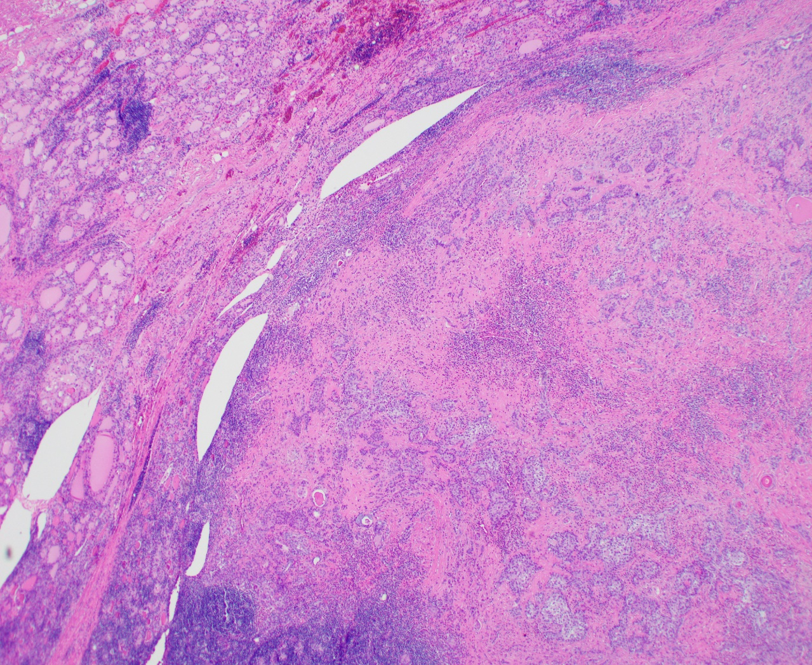
2.9 cm thyroid nodule

Slide 3
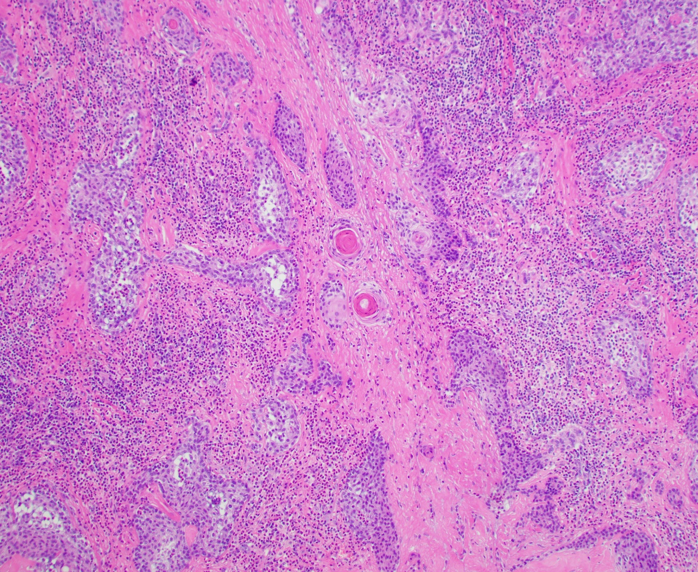

Slide 4
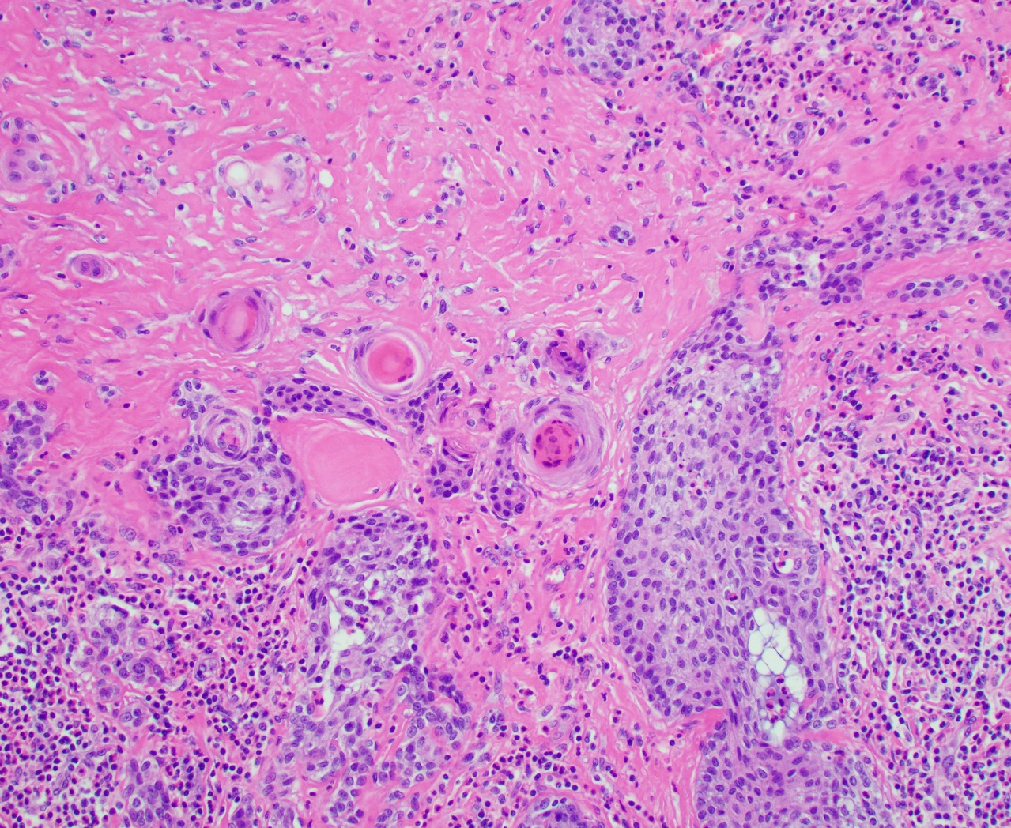

Slide 5
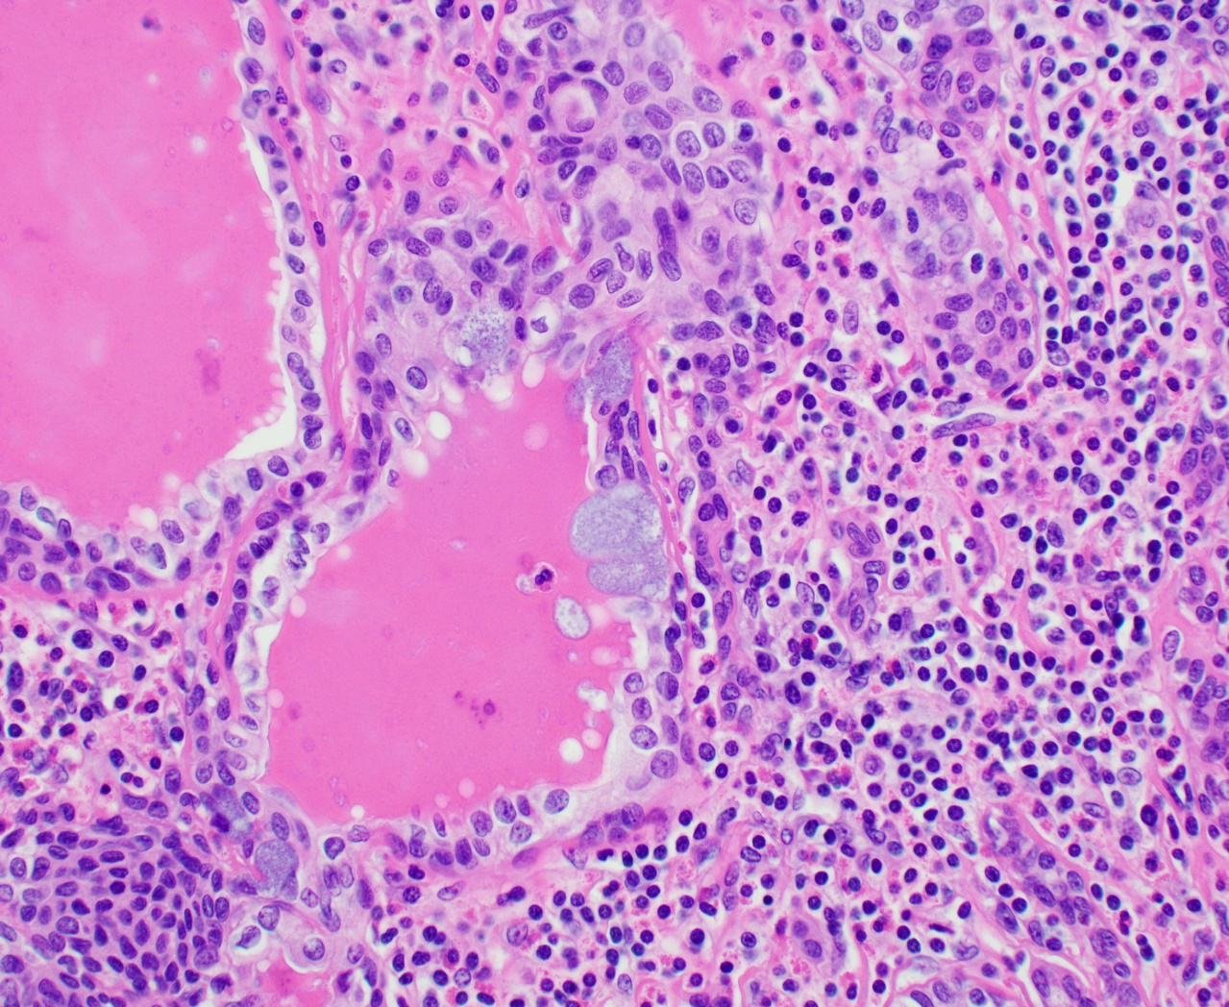

Slide 6
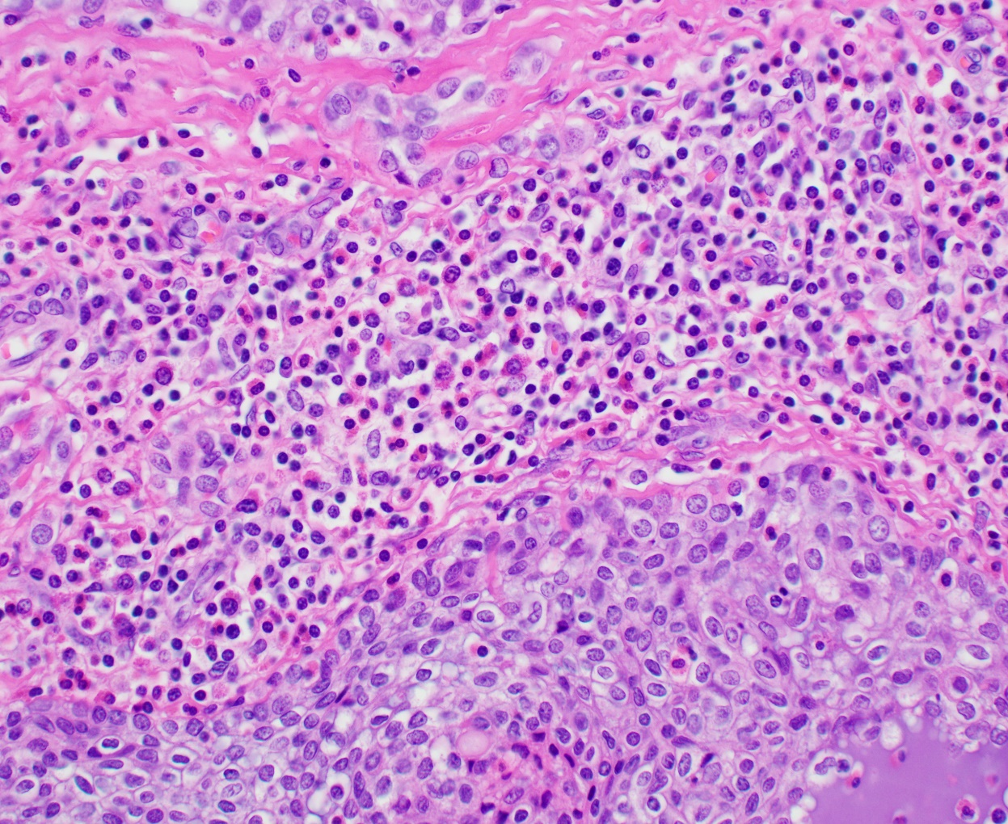
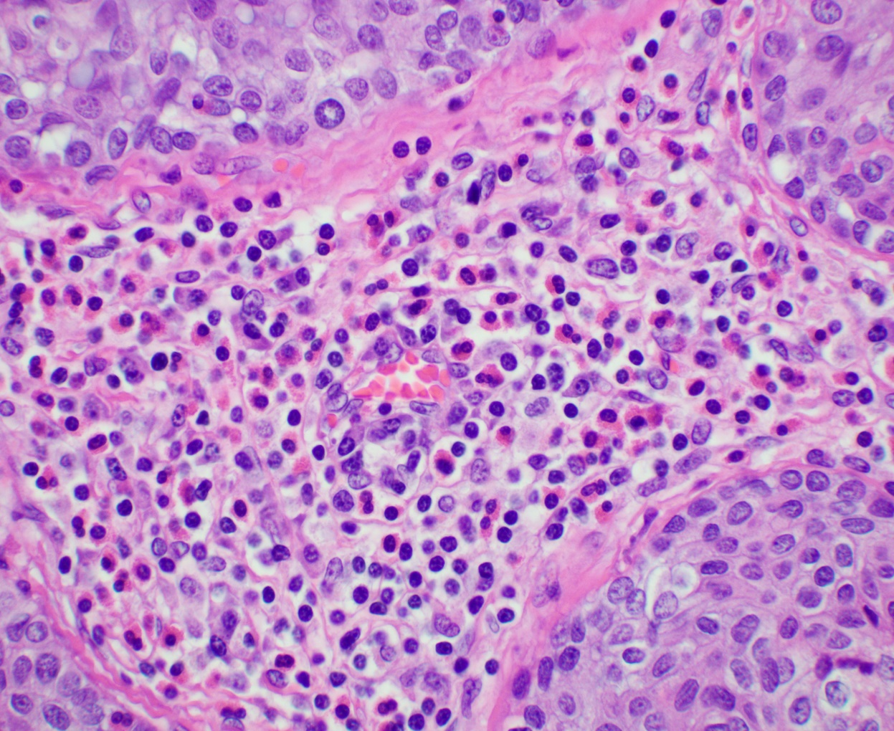

Slide 7
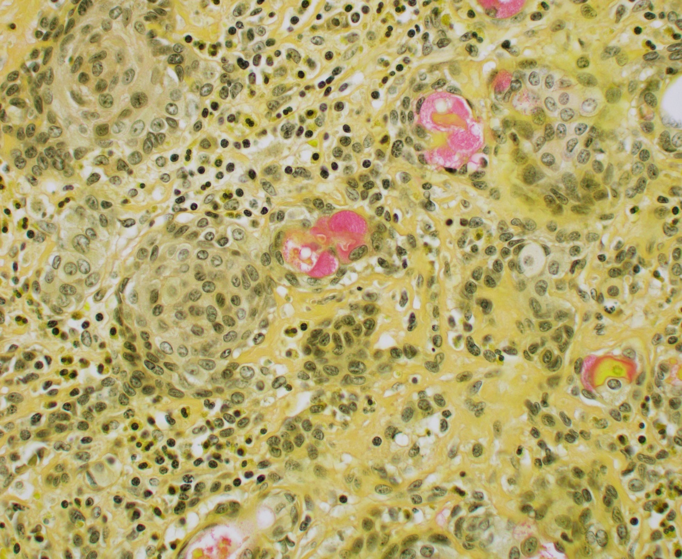
Mucin stain

Slide 8
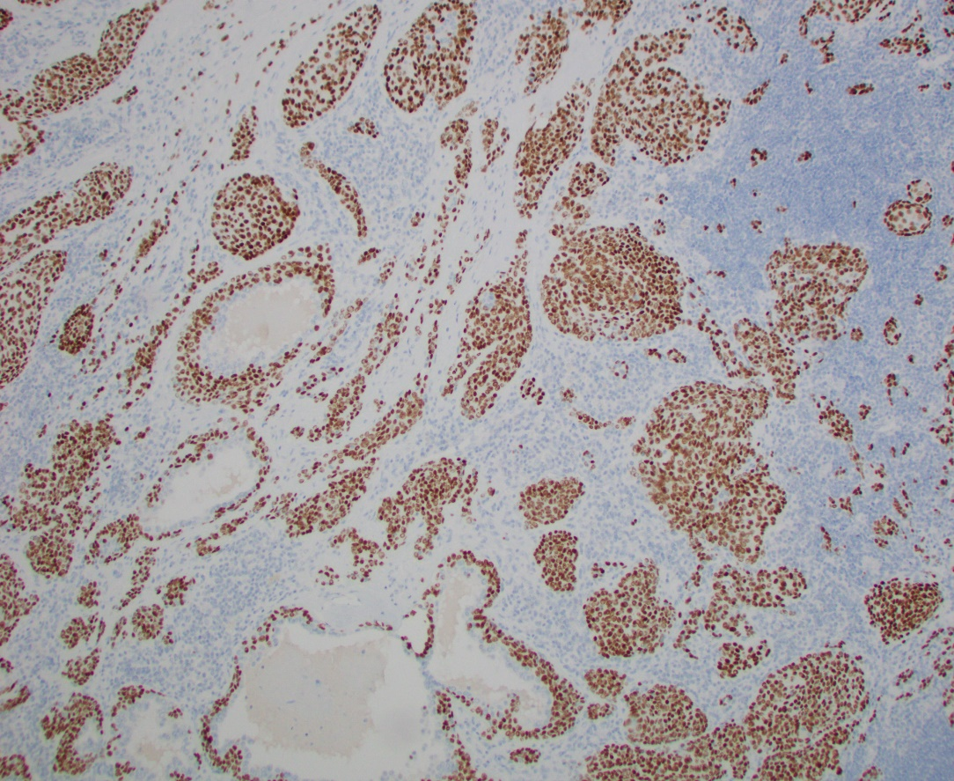
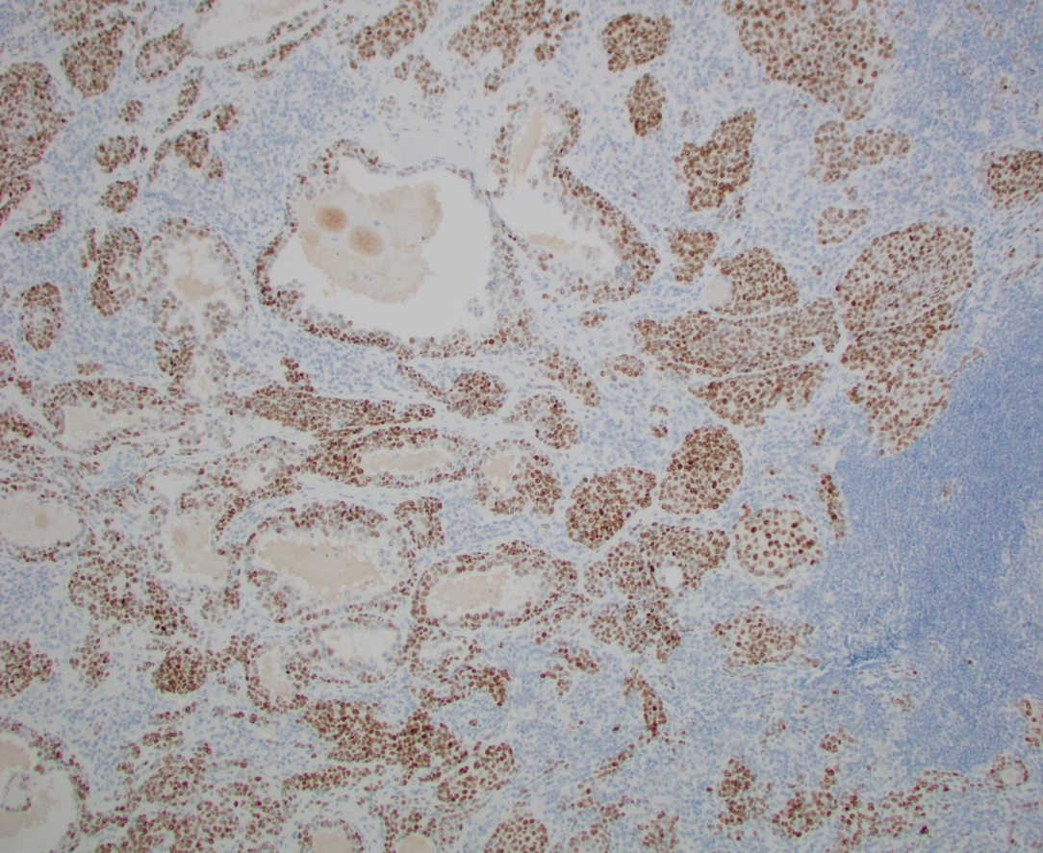
IMMUNOSTAINS
p40
TTF-1

Slide 9
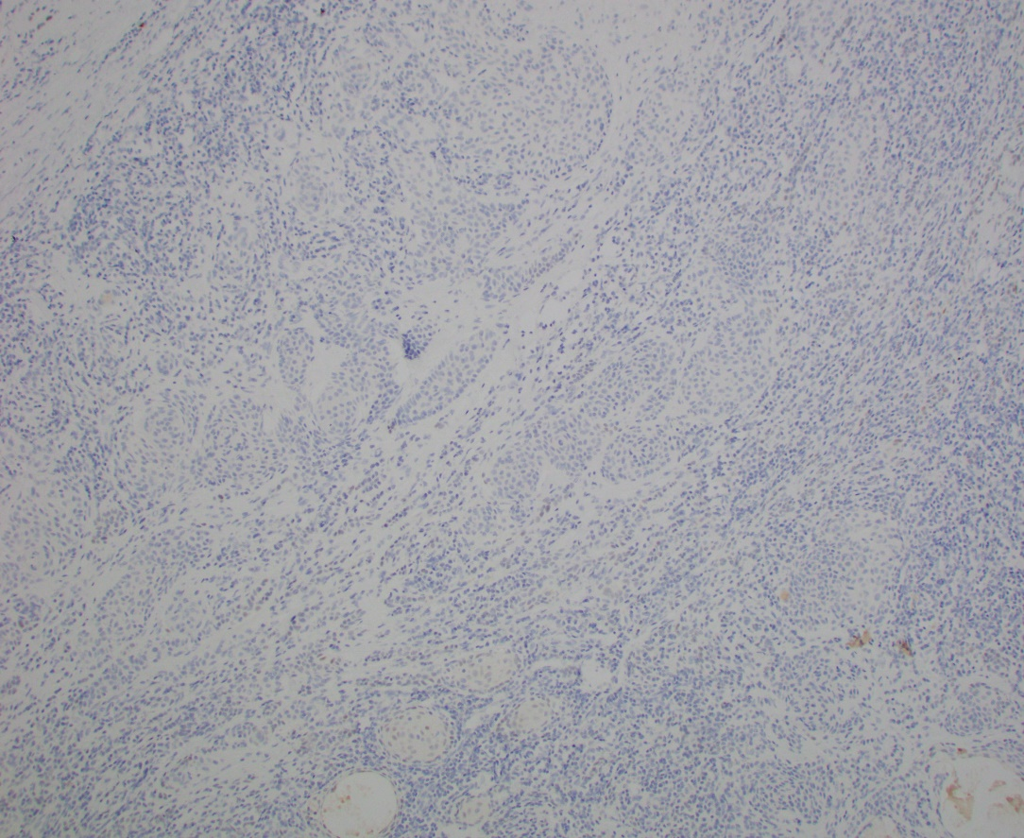
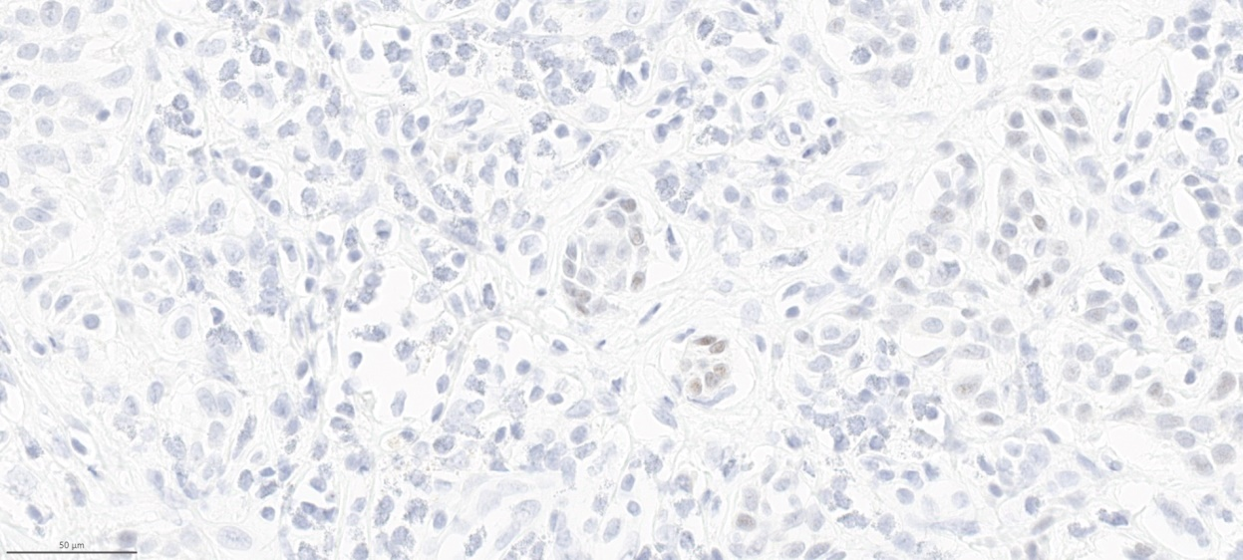
IMMUNOSTAINS
PAX8 low power
PAX8 high power

Slide 10
Other immunostains
Positive
Negative
CK7 (glandular cells)
Thyroglobulin: Very focally +
BRAFV600E
NRASQ61R

