Slide 1
CASE 7
29 year old male, previously healthy, who one month before diagnosis noticed tightness around his neck while he was trying to button his shirt.
Total thyroidectomy, right neck and central compartment neck dissection

Slide 2
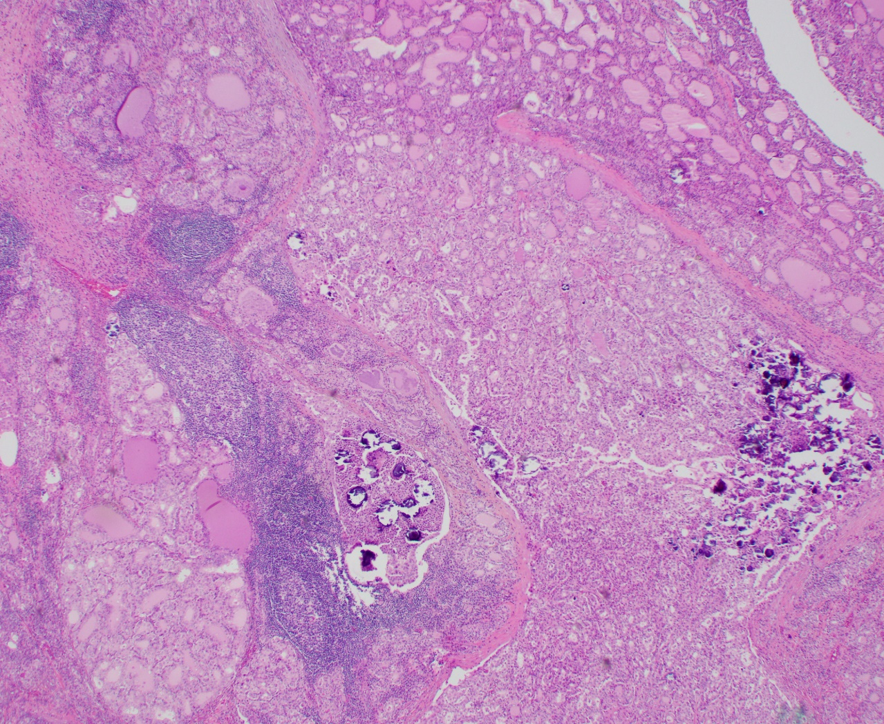
Right thyroid lobe

Slide 3
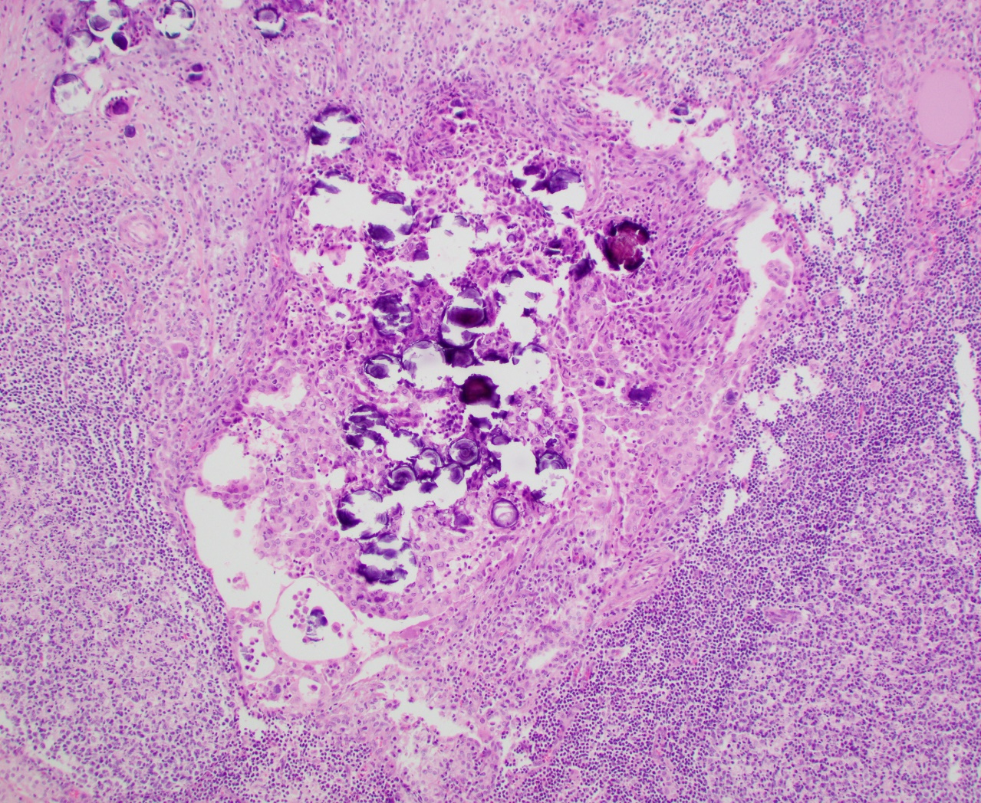

Slide 4
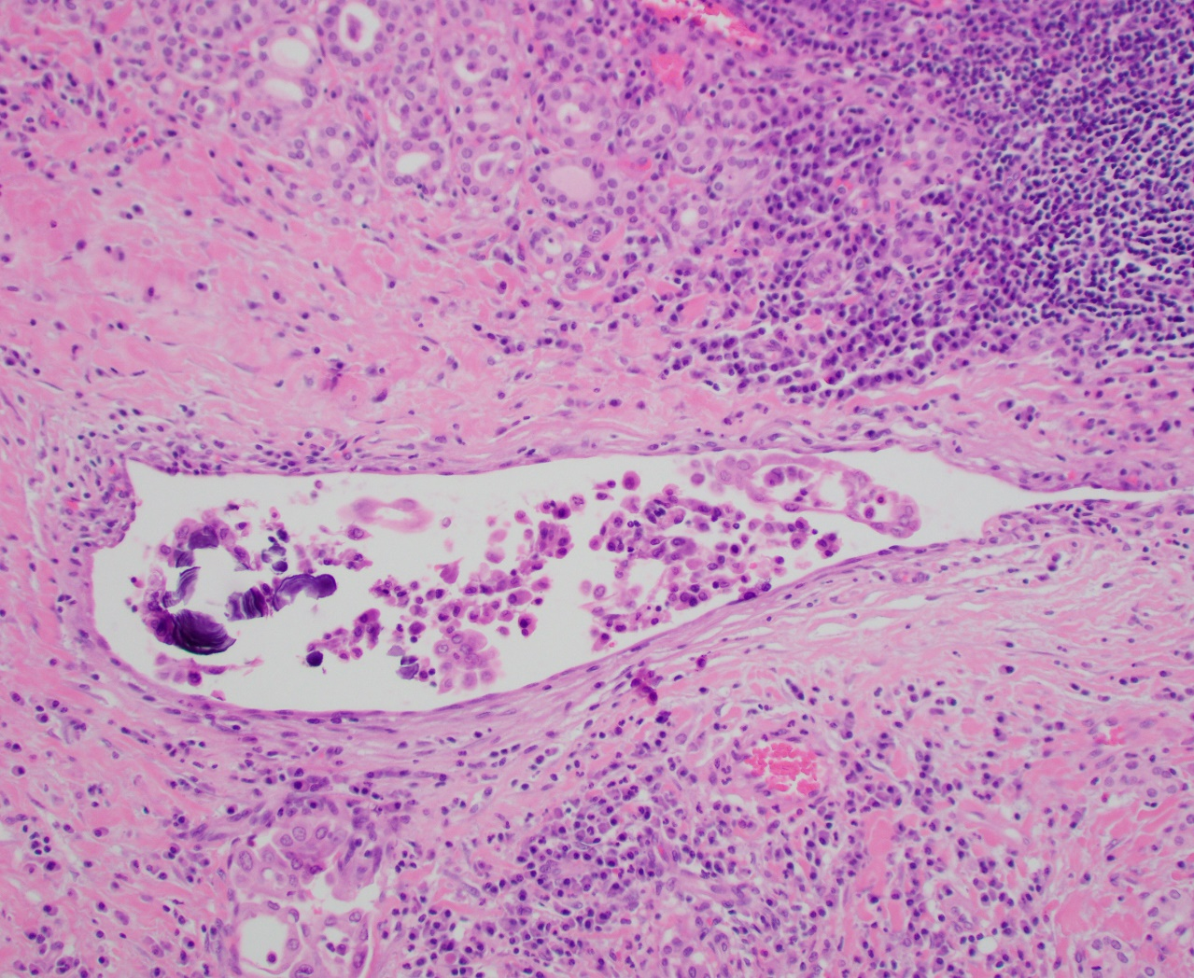

Slide 5
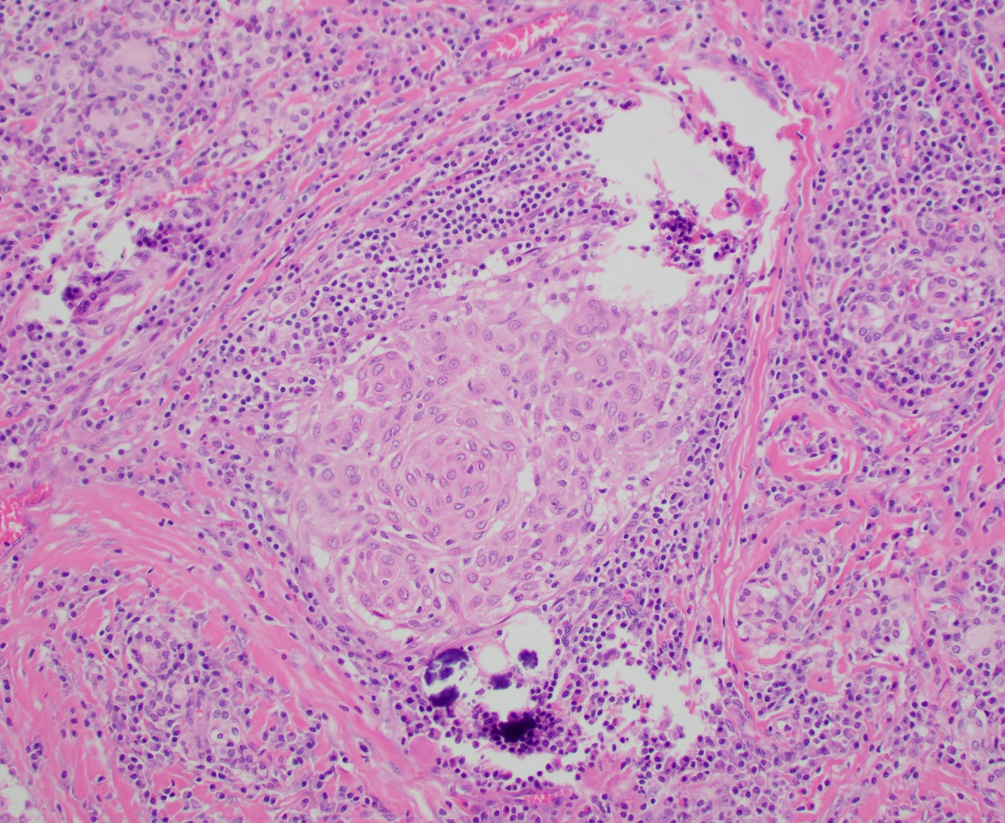

Slide 6
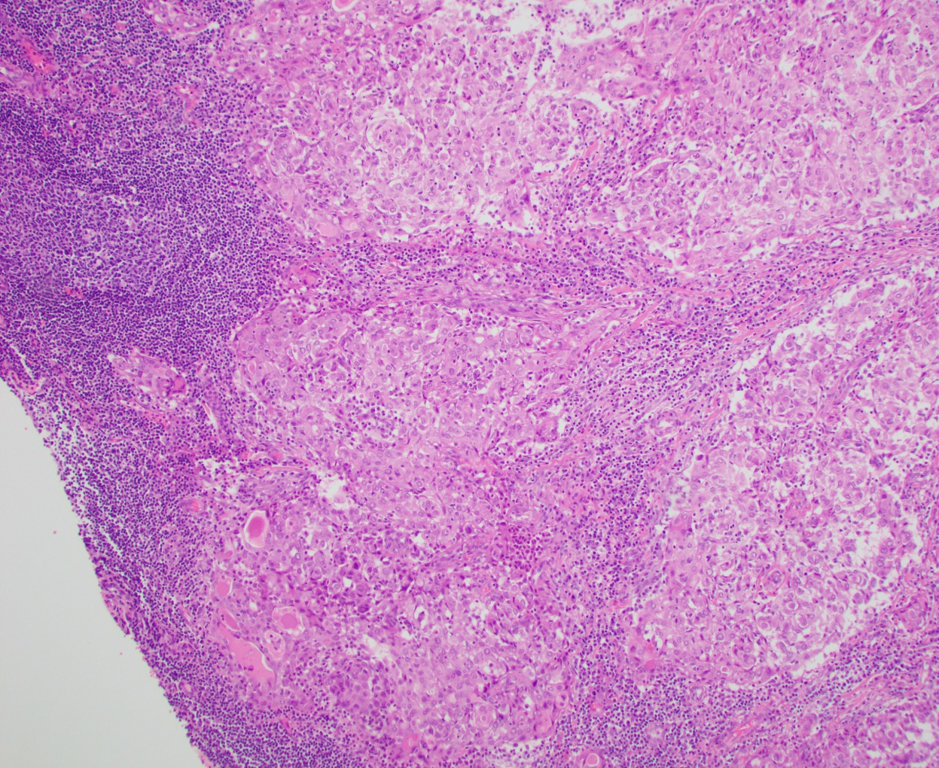
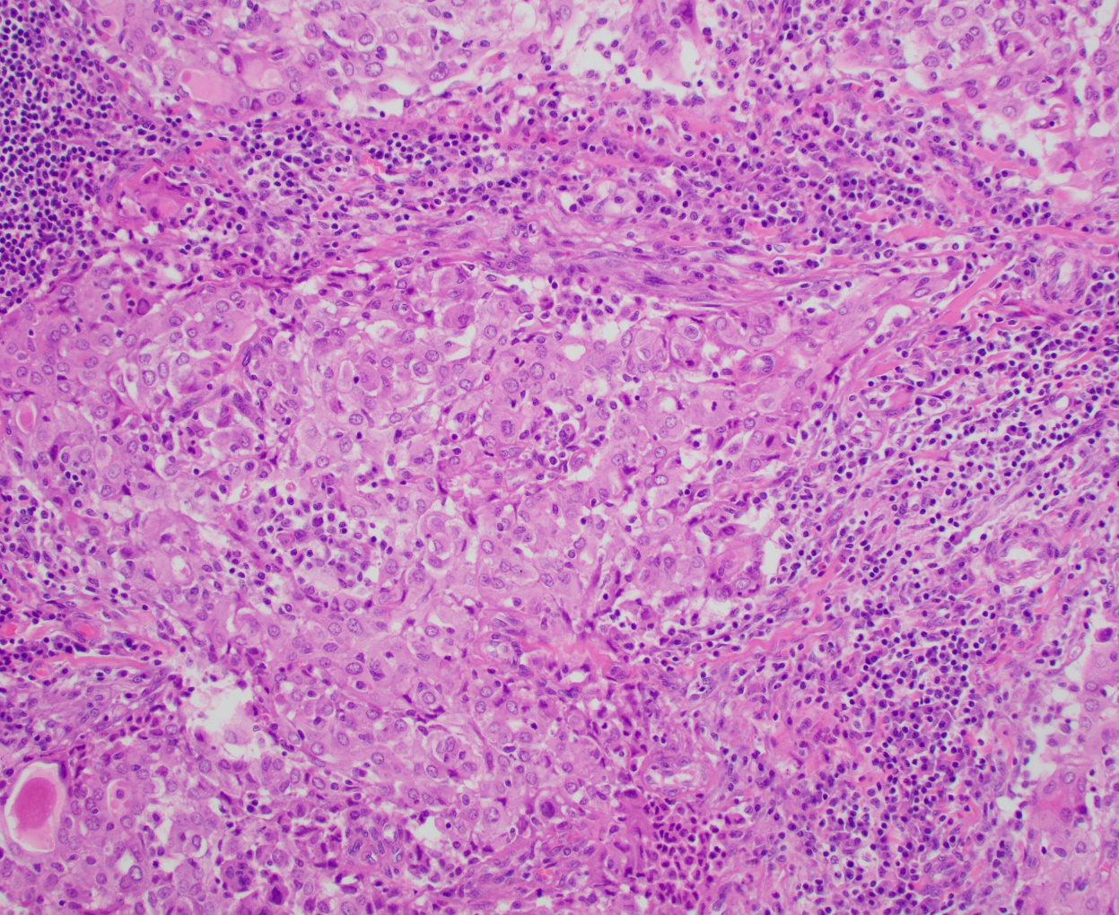
Right neck lymph node

