Slide 1
Case 4
66 year old female with a 6.4 cm dominant mass in the mid and lower pole of right thyroid lobe with caudal extension into superior mediastinum.
Total thyroidectomy with mediastinal mass resection. Right lymph node dissection.

Slide 2
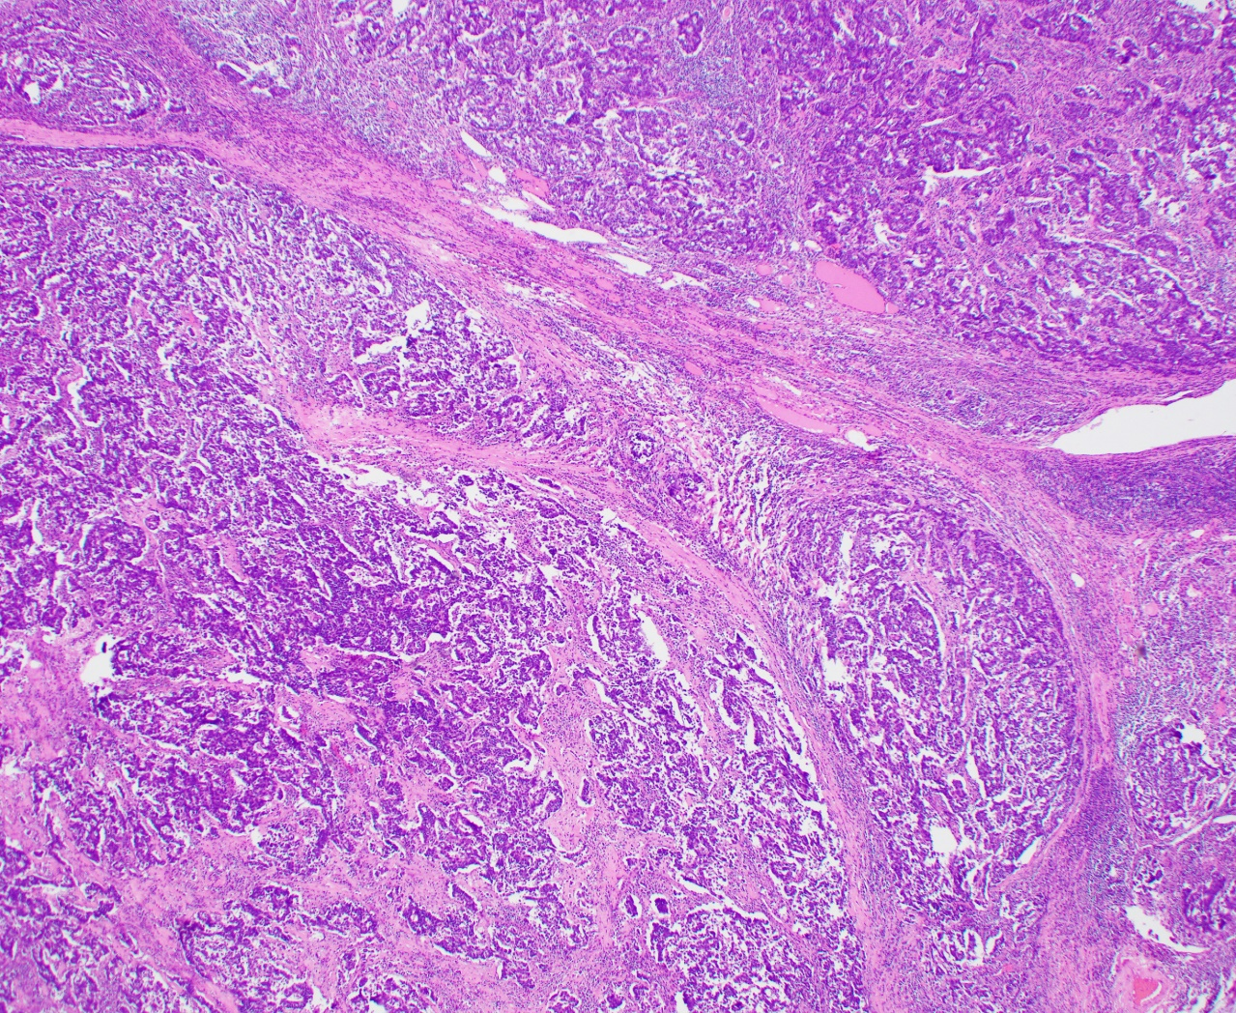

Slide 3
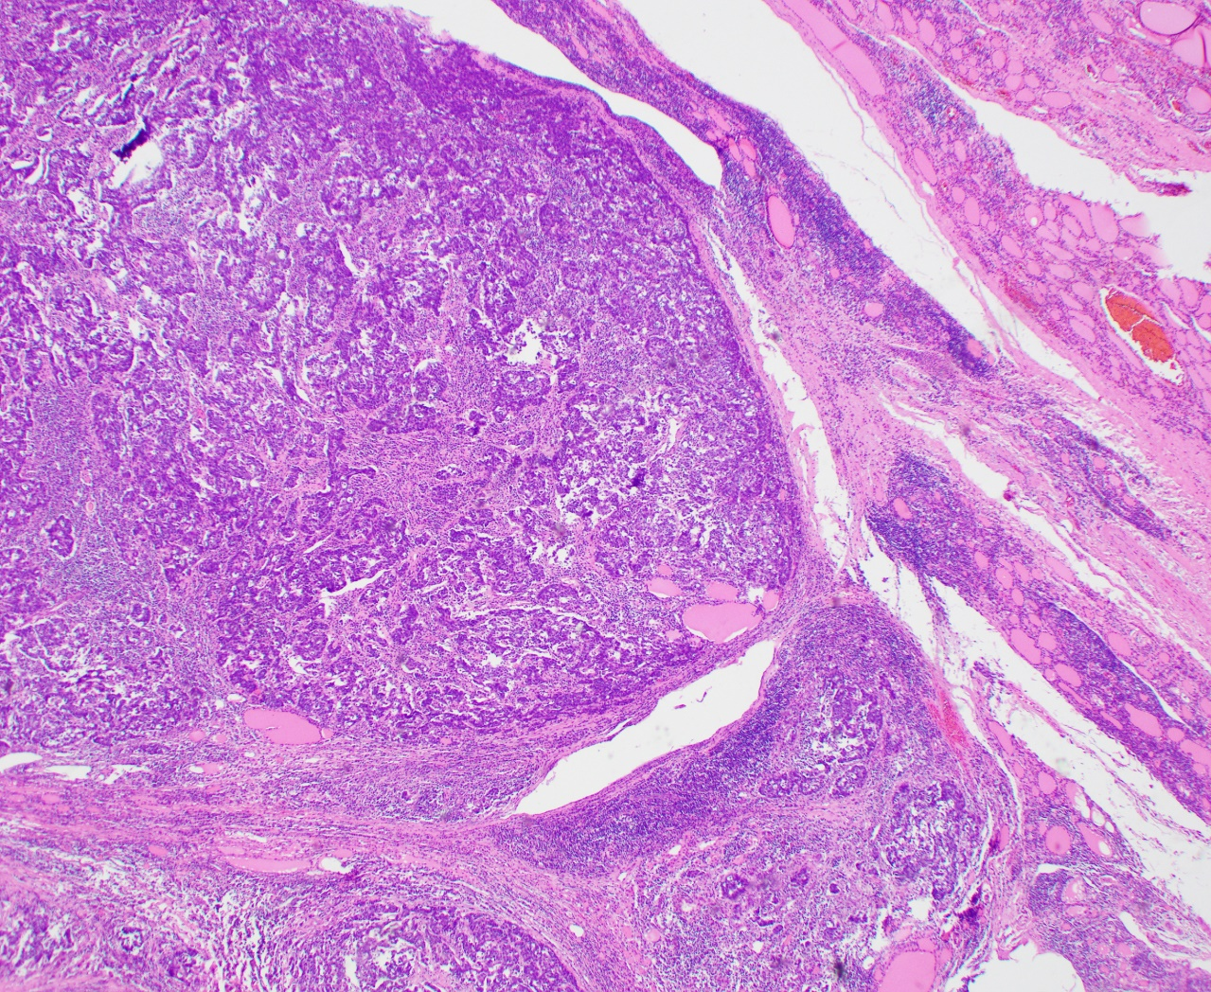

Slide 4
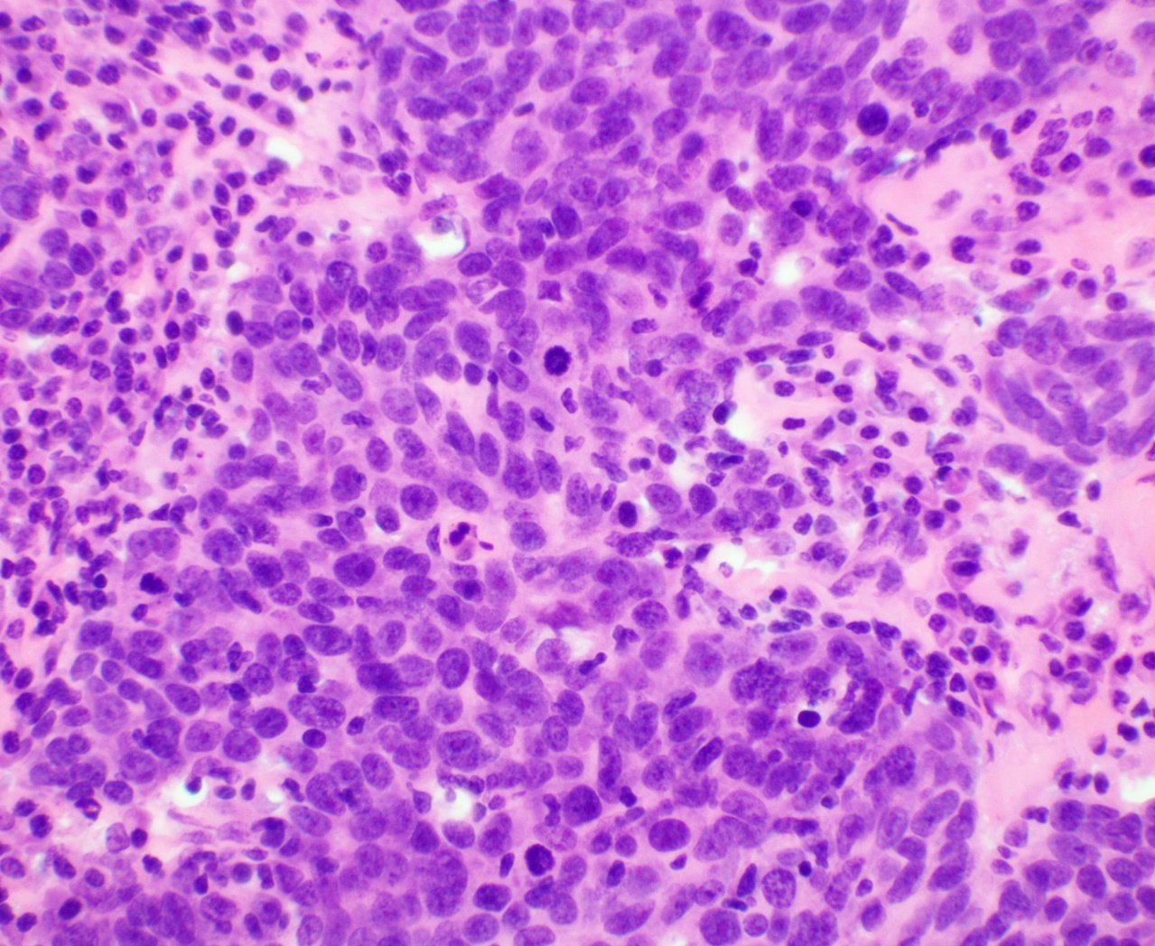

Slide 5
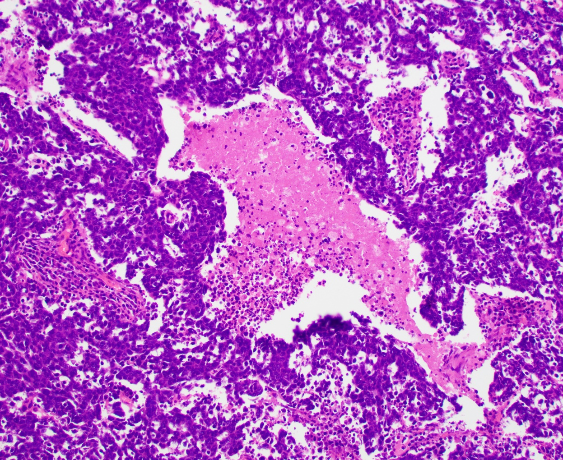
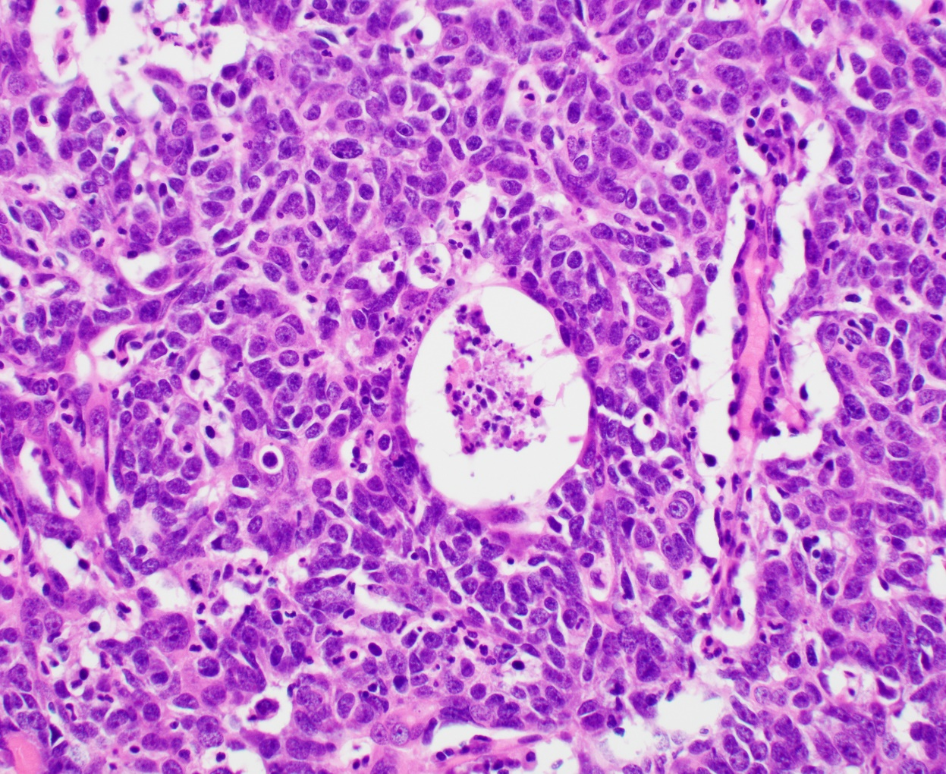

Slide 6
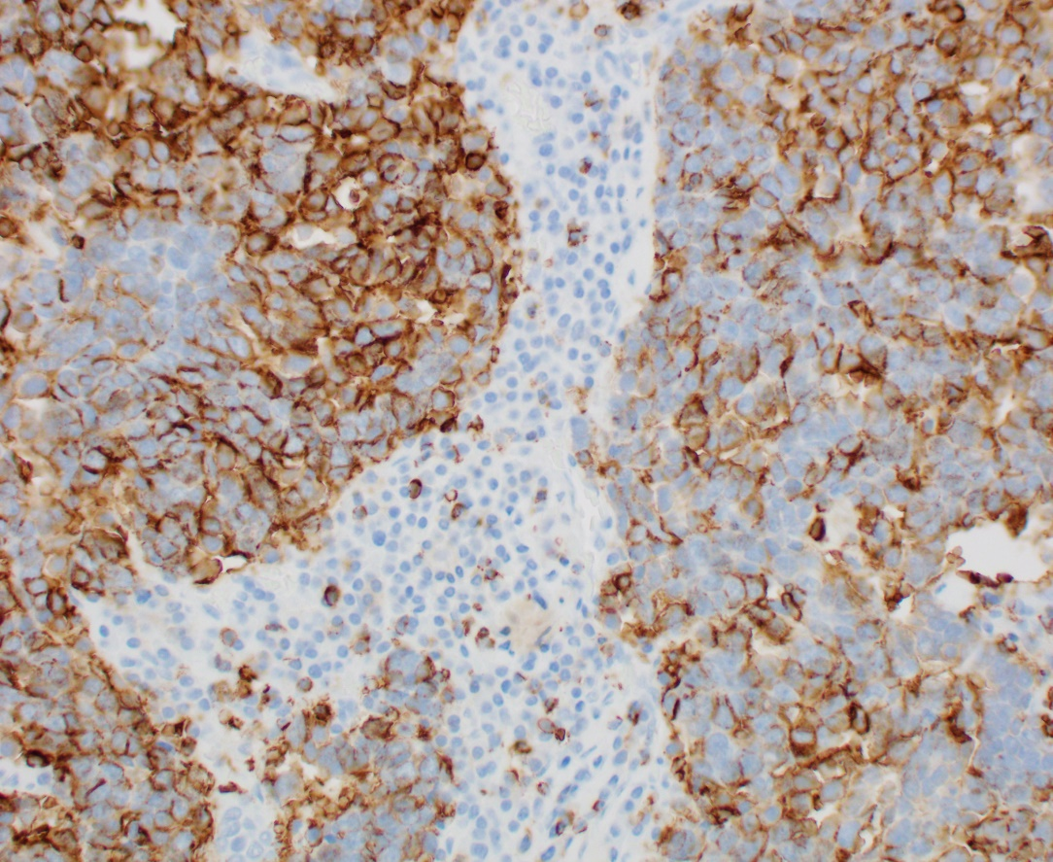
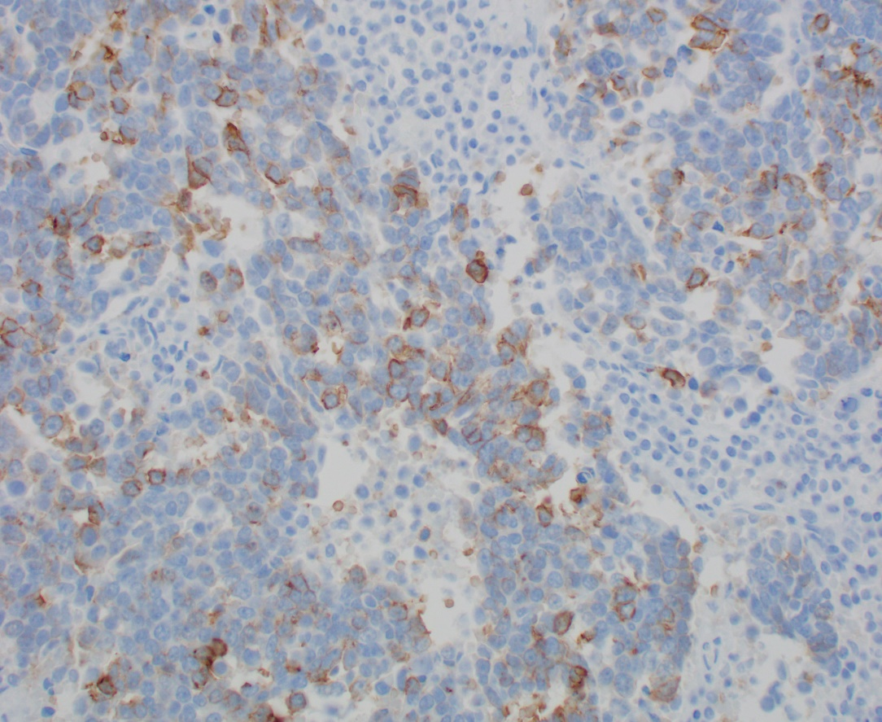
IMMUNOSTAINS
CD5
CD117 (C-KIT)

Slide 7
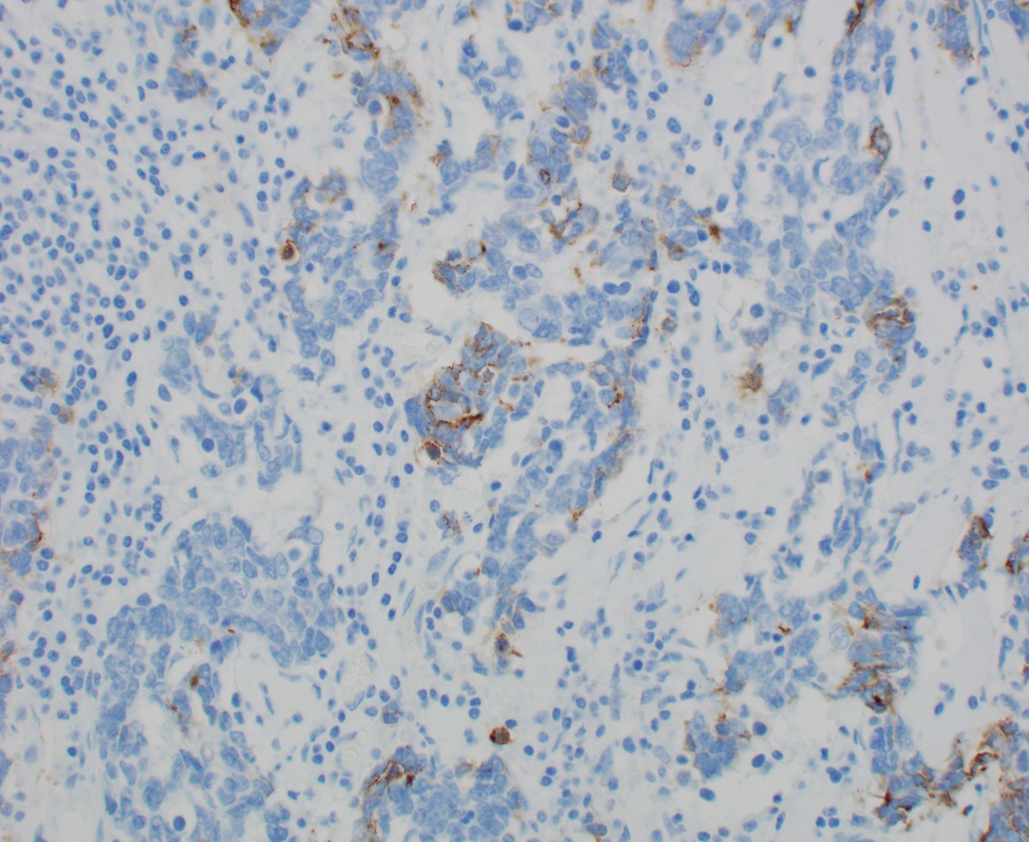
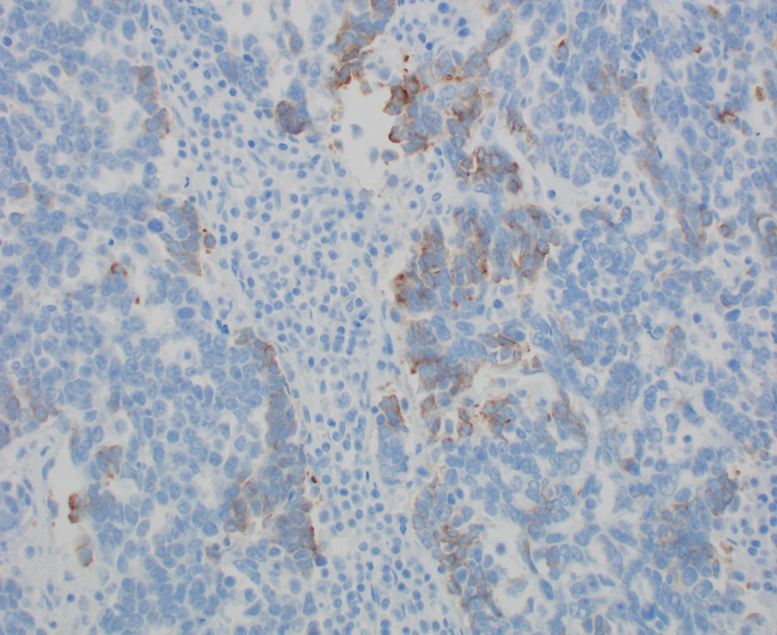
IMMUNOSTAINS
Chromogranin
Synaptophysin

Slide 8
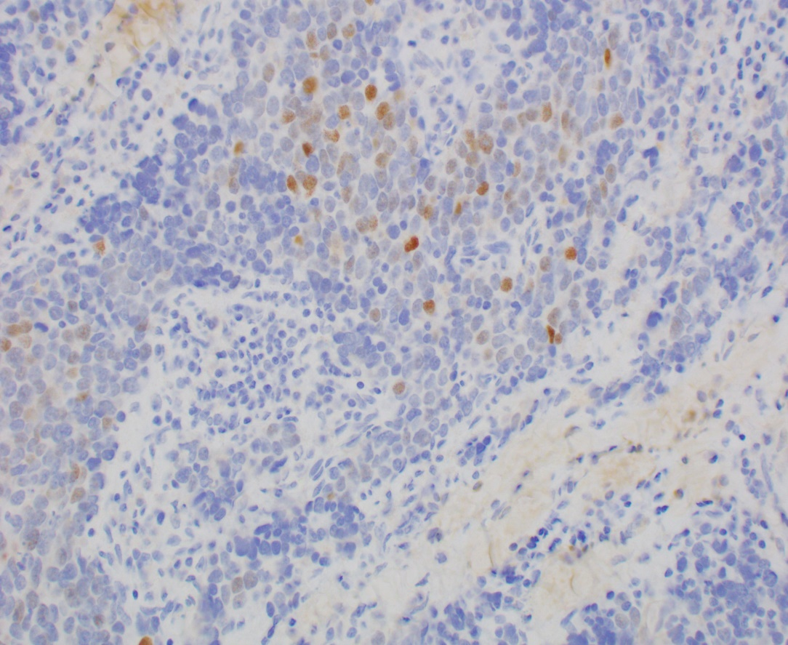
IMMUNOSTAINS
Other markers
POU2-F3
AE1:AE1 cytokeratins: +
P40: +
TTF1, PAX8, TGB: negative
BRAFV600E, calcitonin: Negative
NUT, CD99: negative
P16, HPV ISH, EBER: negative

